Slide 1
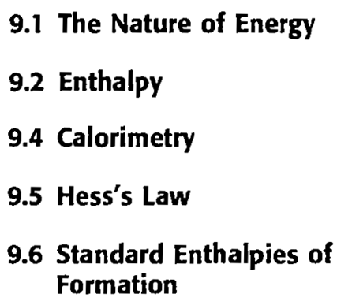
Chapter 8 : Energy, Enthalpy, and Thermochemistry
Chapter 9: Energy, Enthalpy, and Thermochemistry

Slide 2
Energy is the capacity to do work or to produce heat.
Energy is conserved.
The law of conservation of energy states that energy can be converted from one form to another but can be neither created nor destroyed.
The energy of the universe is constant.

Slide 3
Energy can be classified as either potential energy or kinetic energy.
Potential energy is energy due to position or composition.
(example: the energy released when gasoline is burned results from differences in the attractive forces between nuclei and electrons in the reactants and products)
The kinetic energy of an object is due to the motion of the object and depends on the mass of the object (m) and its velocity (v): KE = ½(mv²)

Slide 4
There are two ways to transfer energy: through work and through heat.
Heat involves the transfer of energy between two objects due to a temperature difference.
Work is defined as a force acting over a distance.
Energy change is independent of the pathway; however, work and heat are both dependent on pathway.
A state function (or a state property) refers to a property of the system that is independent of the particular pathway taken.
Energy is a state function, but work and heat are not state functions.

Slide 5
Chemical energy
The system is the part of the universe on which we wish to focus attention.
The surrounding include everything else in the universe.
In a chemical system we define the system as the reactants and the products of the reaction.
The surroundings consist of the reaction container, the room, and everything else other than the reactants and products.

Slide 6
When a reaction results in the evolution of heat, it is said to be exothermic; that is, energy flows out of the system.
Reactions that absorb energy from the surroundings are said to be endothermic. That is, when the heat flow is into a system, the process is endothermic.
In any exothermic reaction, the potential energy stored in the chemical bonds is being converted to thermal energy (random kinetic energy) via heat.

Slide 7
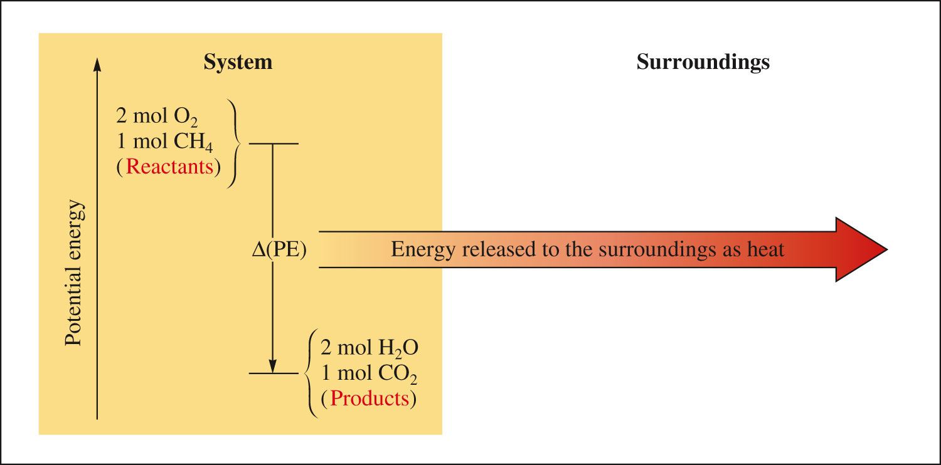
The combustion of methane releases the quantity of energy Δ(PE) to the surroundings via heat flow.
This is an exothermic process.

Slide 8
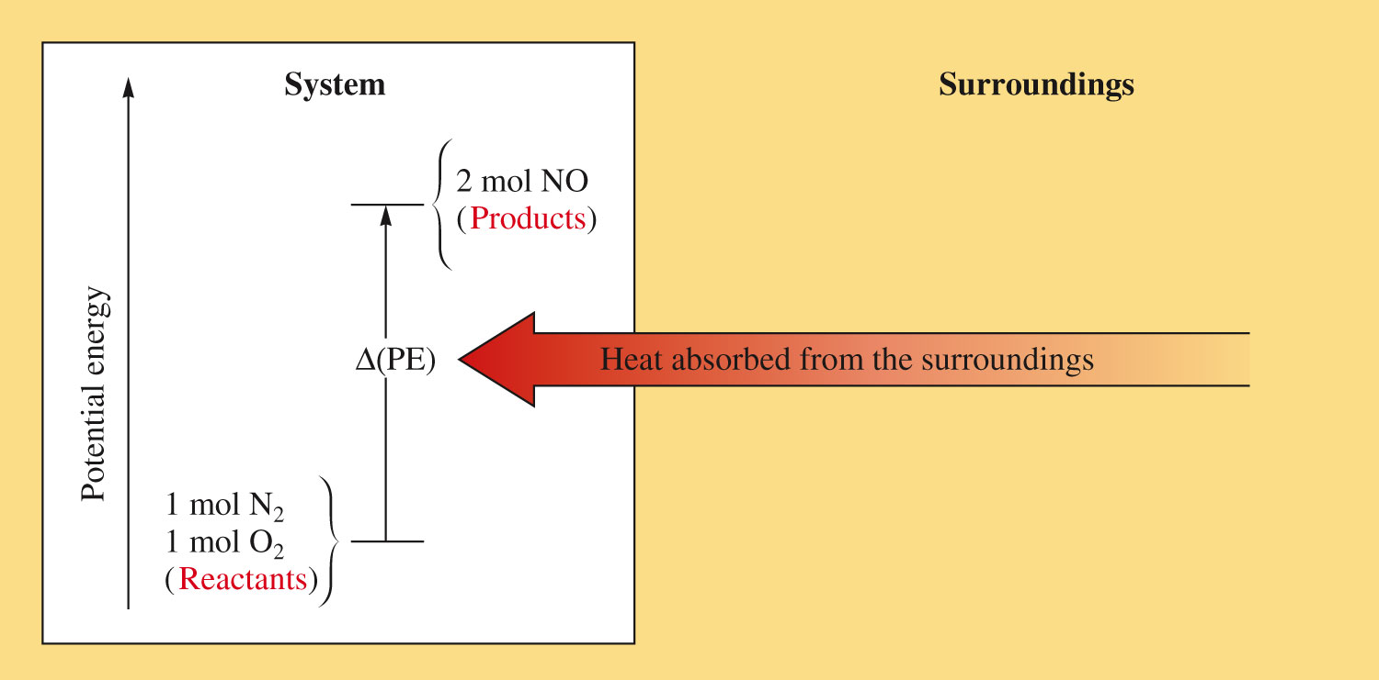
Energy that flows into the system as heat is used to increase the potential energy of the system.
This is an endothermic process.

Slide 9
The study of energy and its interconversions is called thermodynamics.
The internal energy (E) of a system can be changed by a flow of work, heat, or both.
ΔE = q + w
ΔE is the change in the system’s internal energy
q represents heat
w represents work

Slide 10
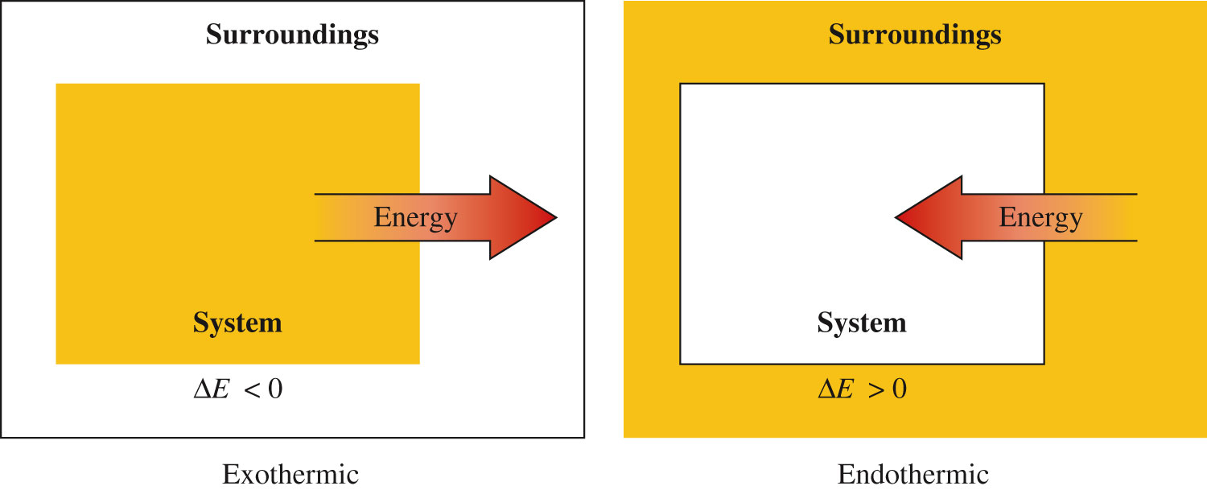
Thermodynamic quantities consist of two parts: a number (giving the magnitude of the change); and a sign (indicating the direction of the flow.
Negative sign indicates that the system’s energy is decreasing.
Positive sign indicates that the system’s energy is increasing.

Slide 11
If the system does work on the surroundings → energy flows out of the system → w is negative.
If the surroundings do work on the system → energy flows into the system → w is positive.
We always take the system’s point of view.

Slide 12
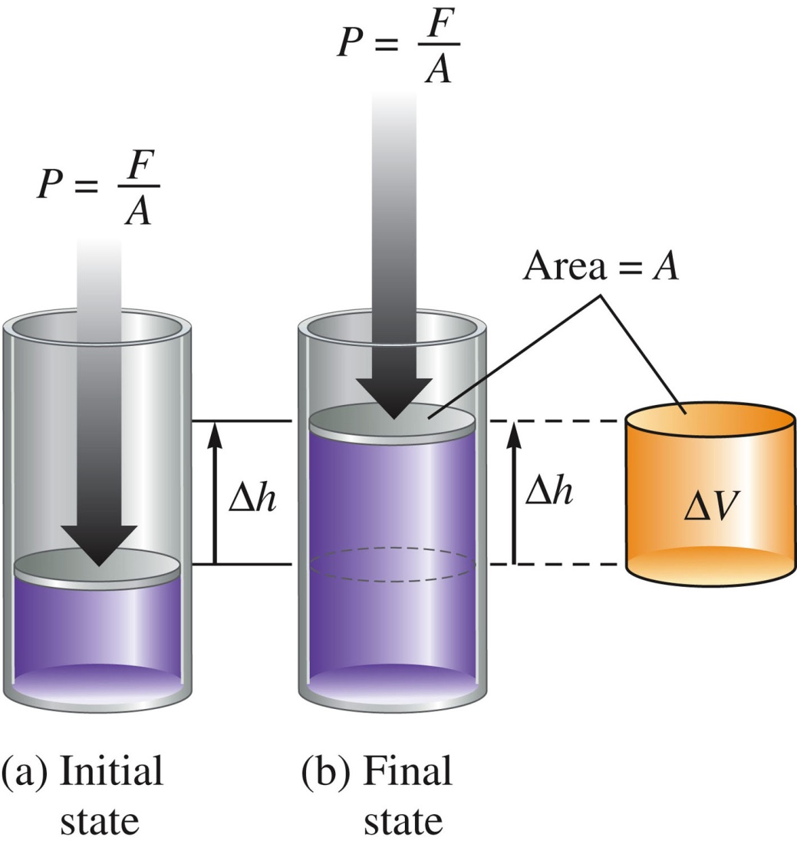
A common type of work associated with chemical processes is work done by a gas (through expansion) or work done to a gas (through compression).
Suppose we have a gas confined to a cylindrical container with a movable piston.
F is the force acting on a piston of area A.

Slide 13
The pressure of the gas is defined as force per unit area:
Work is defined as a force applied over a given distance, so if the piston moves a distance Δh, then the magnitude of the work is:
The change in volume, ΔV, resulting from the piston moving a distance Δh is:
Therefore,
w and PΔV have opposite signs since when the gas expands (ΔV is positive), work flows into the surrounding (w is negative). This leads to the equation:

Slide 14
For a gas expanding against an external pressure P, ΔV is positive and w is negative, since work flows out of the system.
When a gas is compressed, ΔV is negative and w is positive, since work flows into the system.
P in PΔV refers to the external pressure. The pressure that causes a compression or that resists an expansion.
The work accompanying a change in volume of a gas is often called “PV work”.

Slide 15
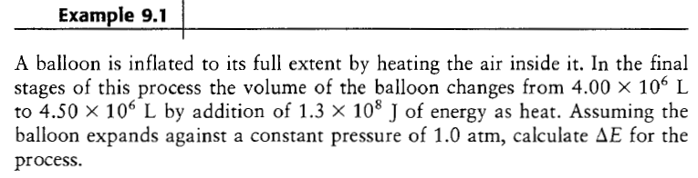

Slide 16
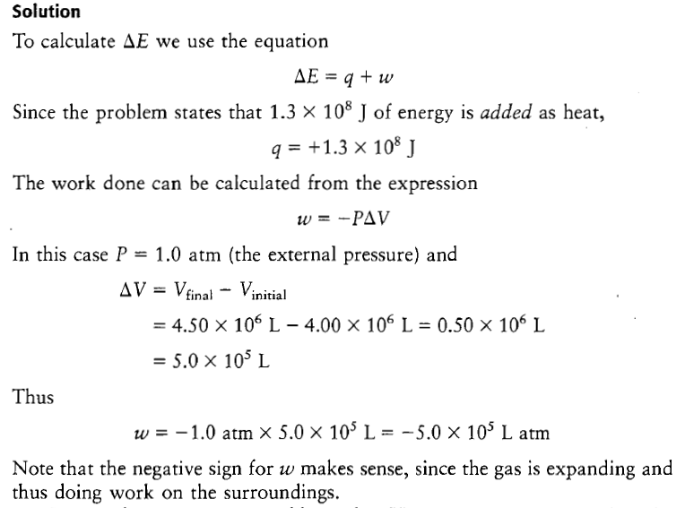

Slide 17
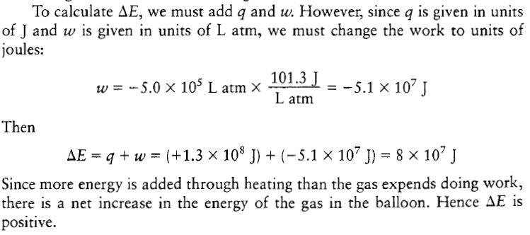

Slide 18
Enthalpy (H) is:
H = E + PV
E: the internal energy of the system
P: pressure of the system
V: volume of the system
Enthalpy is a state function.
Consider a process carried out at constant pressure, where the only work allowed is PV work (w = - PΔV):
ΔE = q_{p} + w = q_{p} – PΔV
→ q_{p} = ΔE + PΔV
where q_{p} is the heat at constant pressure.

Slide 19
From the definition of enthalpy H = E + PV:
ΔH = ΔE + Δ(PV)
At constant pressure
ΔH = ΔE + PΔV
This expression is identical to q_{p} = ΔE + PΔV → ΔH = q_{p}
At constant pressure (where only PV work is allowed), the change in enthalpy (ΔH) of the system is equal to the energy flow as heat.
For a chemical reaction, the enthalpy change is given by:
ΔH = H_{products} – H_{reactants}
H_{products} > H_{reactants} → ΔH > 0 → heat absorbed by the system → the reaction is endothermic
H_{products} < H_{reactants} → ΔH < 0 → heat is generated by the system → the reaction is exothermic

Slide 20
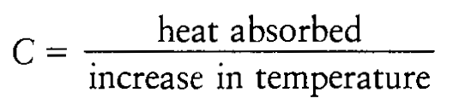
The heat associated with a chemical reaction can be determined experimentally using a calorimeter.
Calorimetry, the science of measuring heat, is based on observing the temperature change when a body absorbs or discharges energy as heat.
The heat capacity of a substance is defined as

Slide 21
In defining the heat capacity of a substance, the amount of substance must be specified.
Specific heat capacity: the energy required to raise the temperature of 1 g of a substance by 1⁰C. Units: J K⁻¹ g⁻¹ or J ⁰C⁻¹ g⁻¹.
Molar heat capacity: the energy required to raise the temperature of 1 mole of a substance by 1⁰C. Unit: J K⁻¹ mol⁻¹ or J ⁰C⁻¹ mol⁻¹.

Slide 22
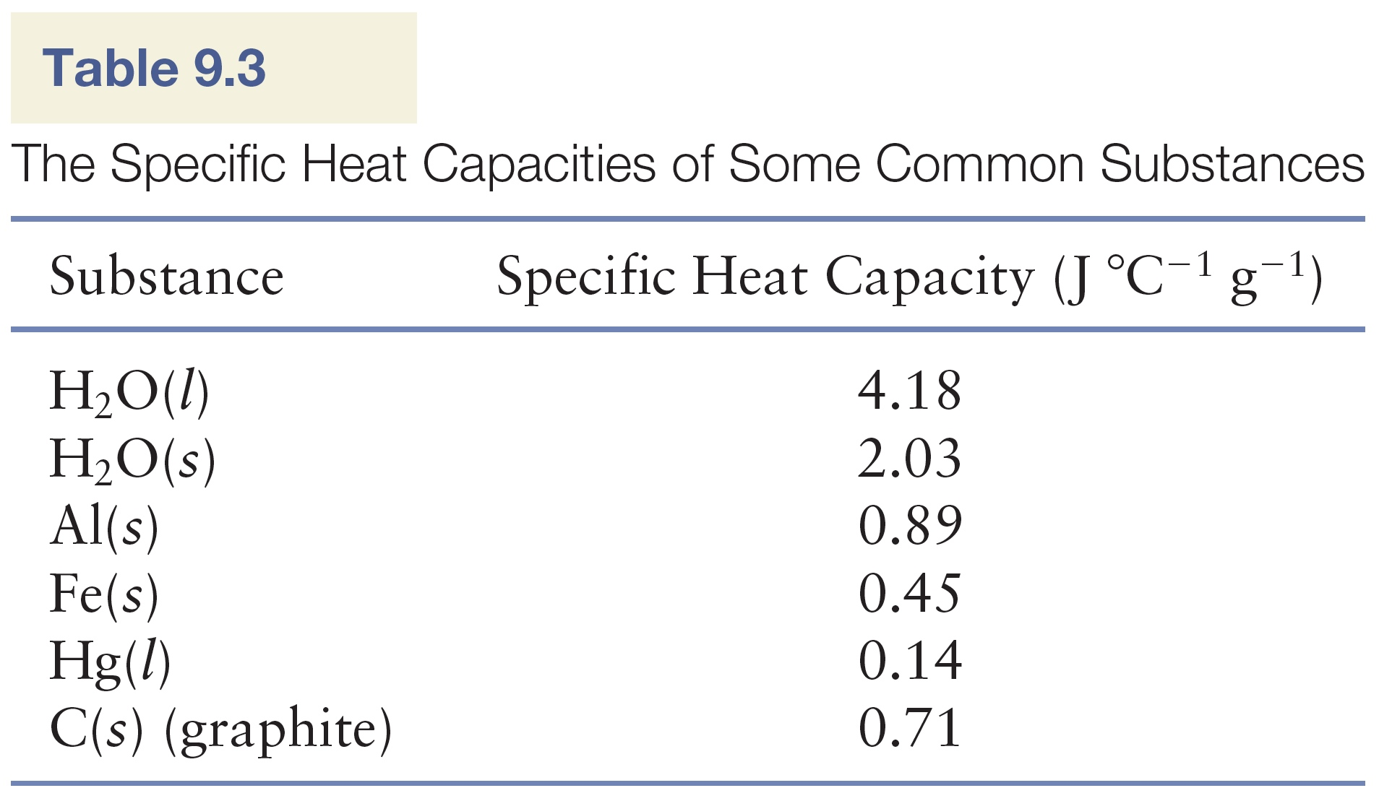

Slide 23
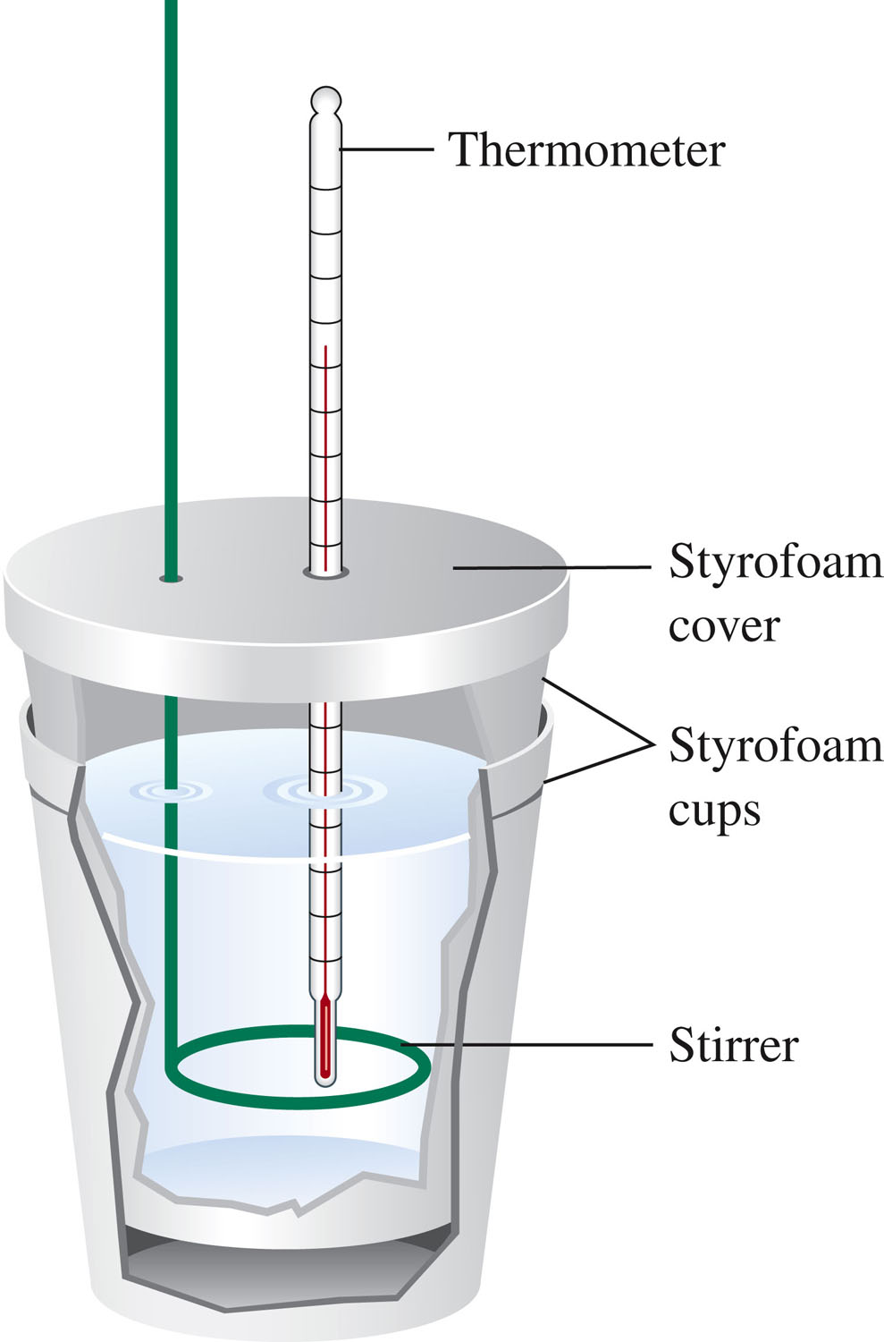
A constant pressure calorimeter is used to determine the changes in enthalpy occurring in solution.
In a constant pressure calorimeter, the pressure (atmospheric pressure) remains constant during the process.
The change in enthalpy equals the heat.

Slide 24
Example:
Mixing 50.0 mL of 1.0 M HCl at 25⁰C with 50.0 mL of 1.0 M NaOH at 25⁰C in a calorimeter, the temperature is observed to increase to 31.9⁰C.
The net ionic equation for this reaction is:
H⁺ (aq) + OH⁻ (aq) → H₂O (l)
Since the temperature of the mixed solution increases, the chemical reaction is releasing energy as heat.
The quantity of energy released can be determined from the temperature increase, the mass of the solution, and the specific heat capacity of the solution.

Slide 25
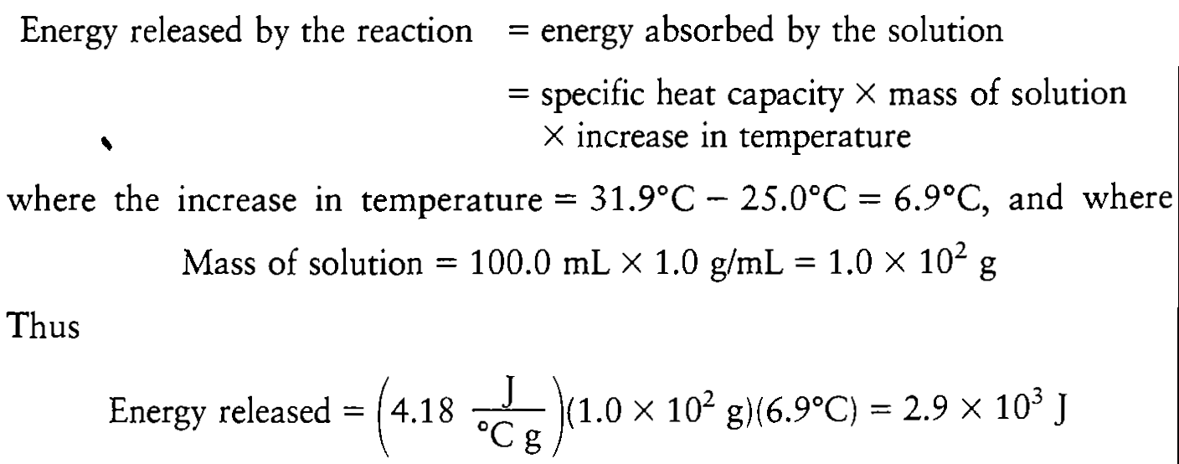

Slide 26
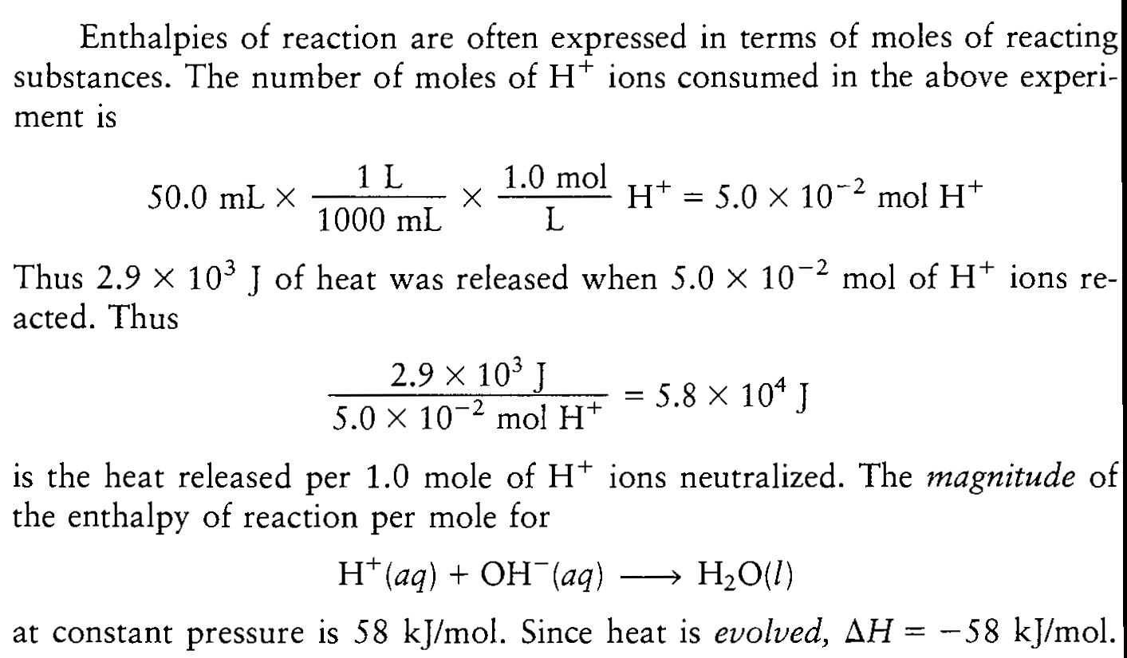

Slide 27
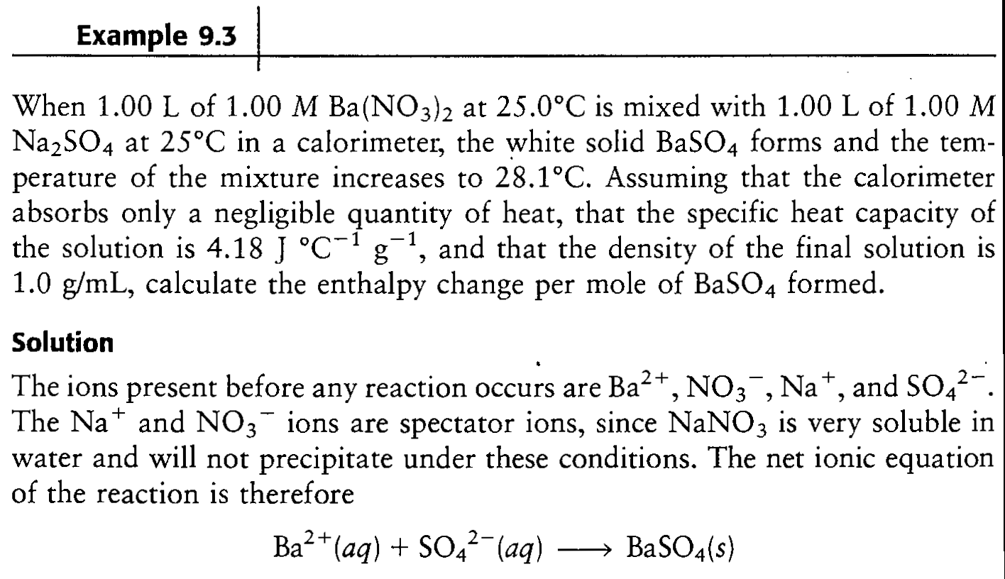

Slide 28
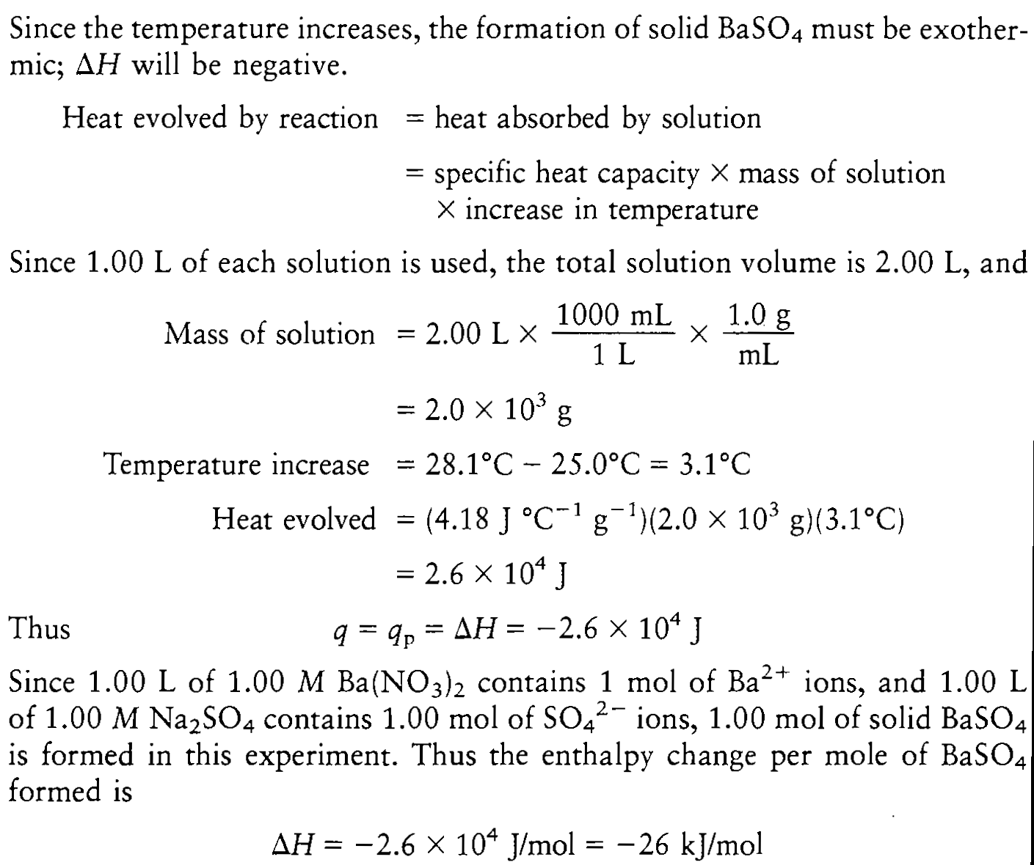

Slide 29
Calculation of ΔH and ΔE for Cases in Which PV Work Occurs
In constant pressure calorimetry, the reactions occur in solution, where no appreciable volume changes occur (the total volume of the reactant solution is the sum of the volumes of solutions that are mixed and remains constant as the reaction proceeds).
Under these conditions (ΔV = 0, PΔV = 0, and w = 0):
ΔE = q_{p} + w = ΔH + 0
However, when a reaction involving gases is considered at constant pressure, ΔE may not equal ΔH.

Slide 30
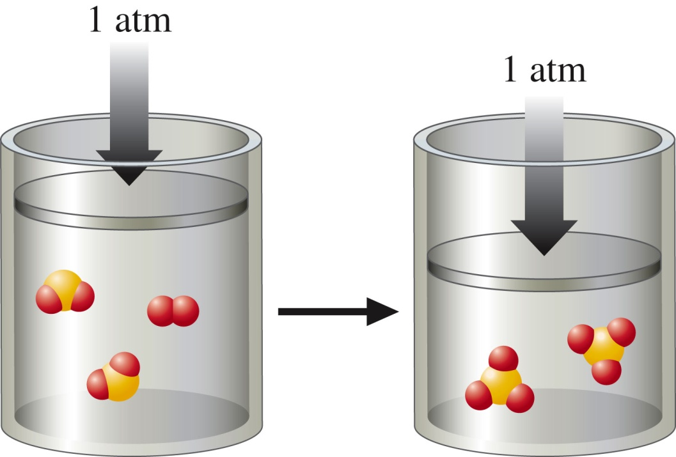
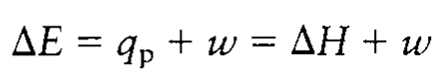
2SO₂(g) + O₂(g) → 2SO₃(g)
In going from reactants to products, the volume of the system decreases because the number of moles of gas decreases.
Thus w>0 and the work flows into the system.
Then:

Slide 31
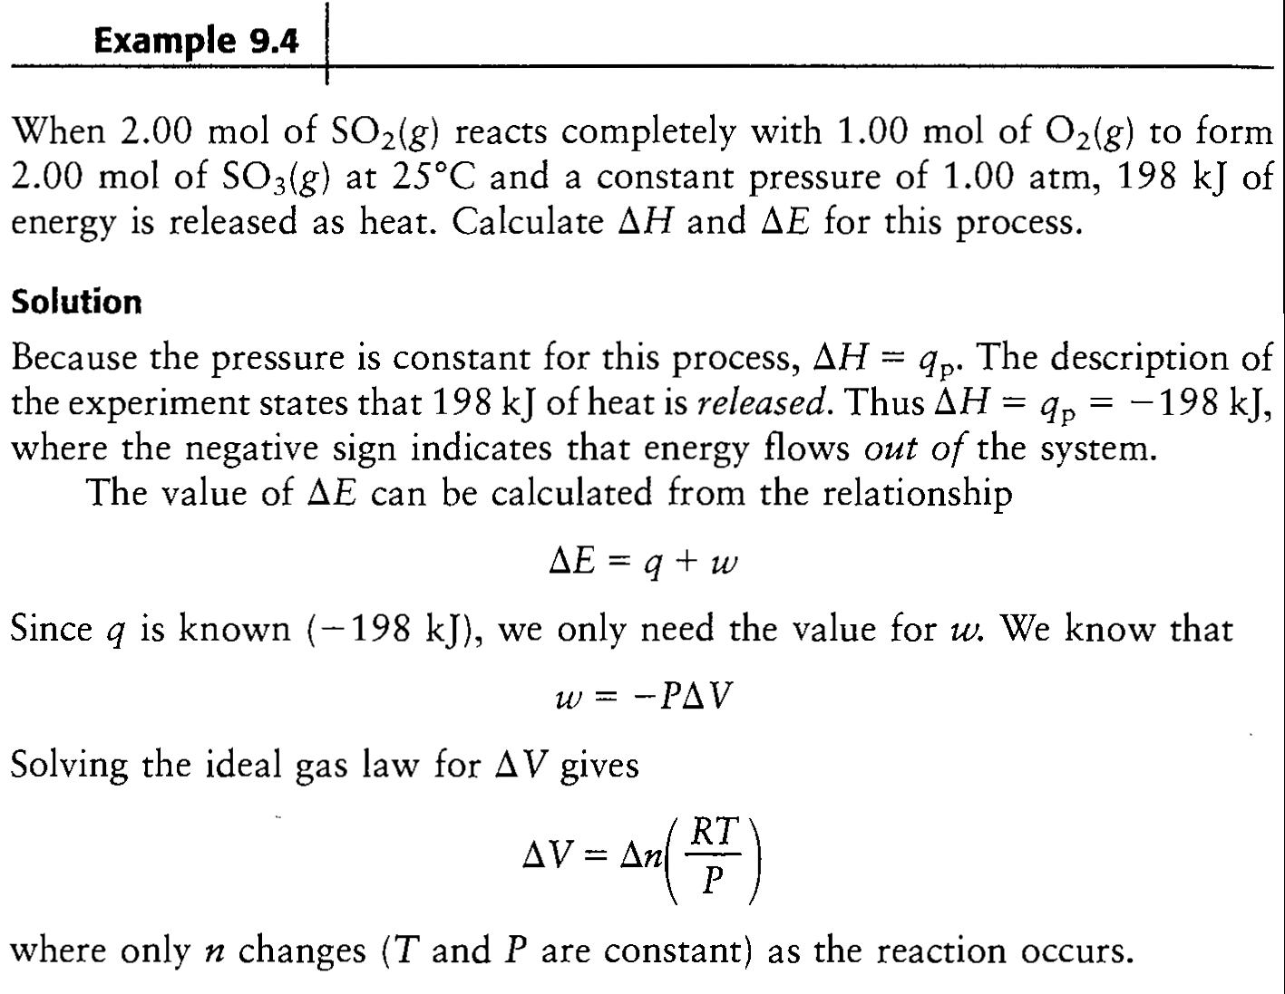

Slide 32
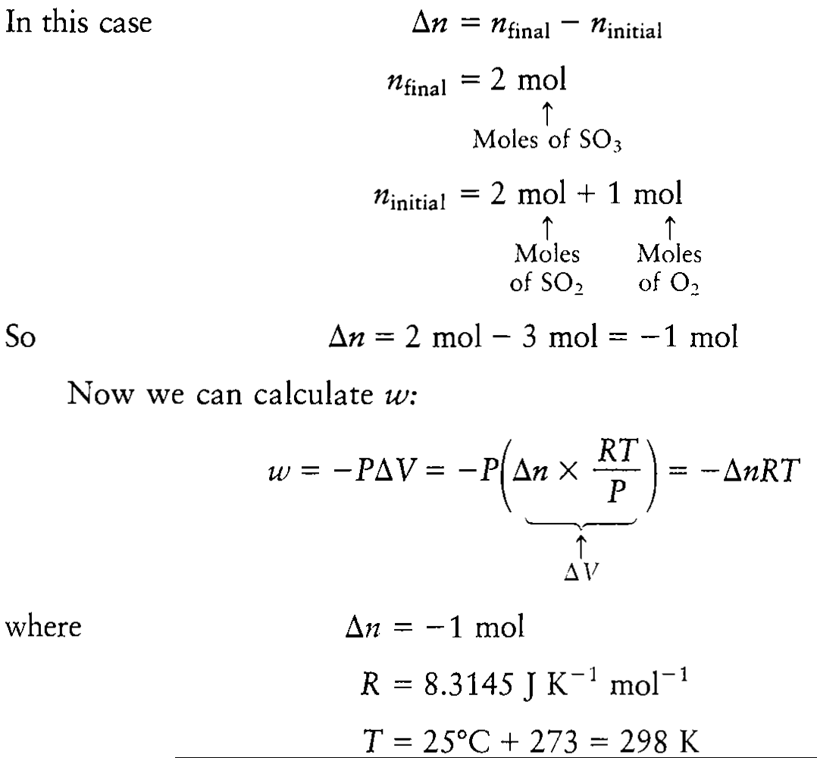
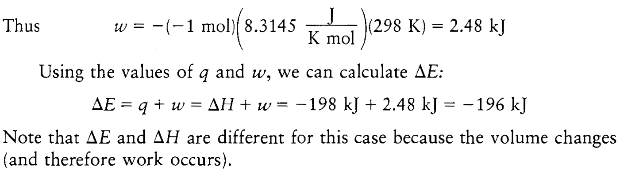

Slide 33
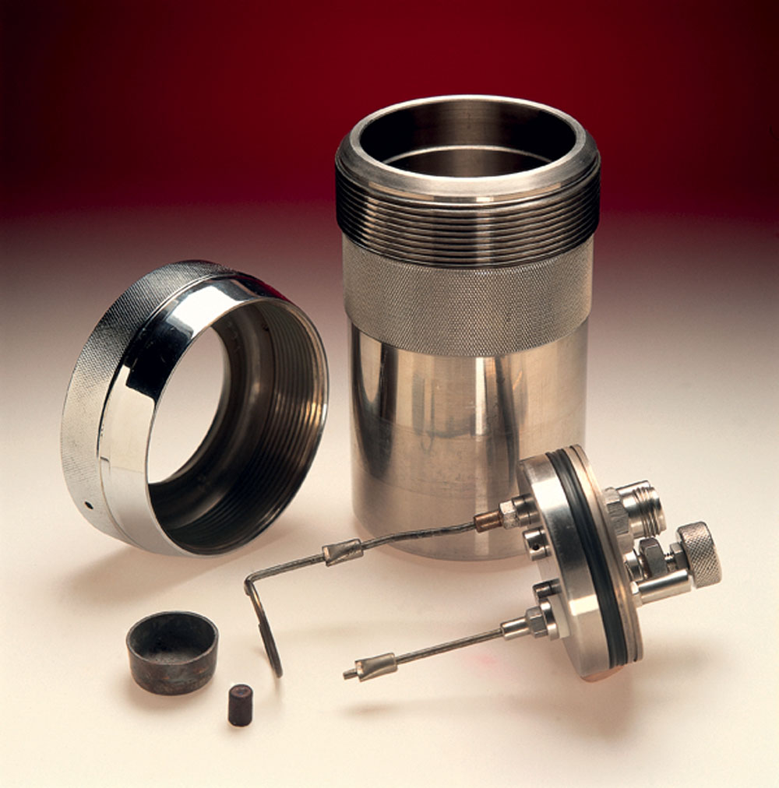
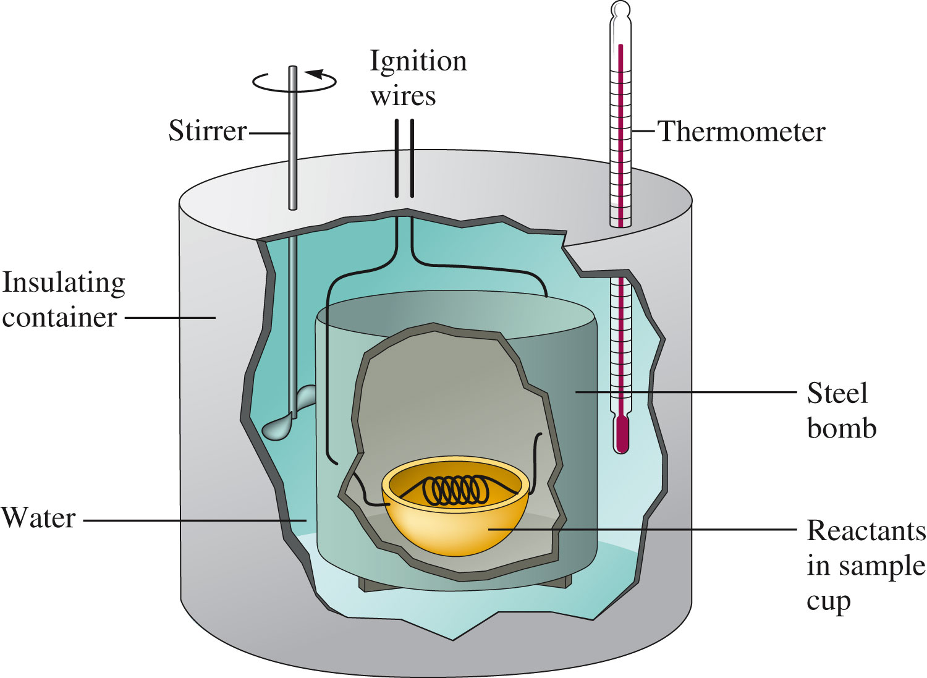
A bomb calorimeter is used to study the energy changes in reactions under conditions of constant volume.
ΔV = 0 and w = 0

Slide 34
Example:
A 0.5269 g sample of octane (C₈H₁₈) is placed in a bomb calorimeter known to have a heat capacity of 11.3 kJ/⁰C (11.3 kJ of energy is required to raise the temperature of the water and other parts of the calorimeter by 1⁰C).
The octane is ignited in the presence of excess oxygen, causing the temperature of the calorimeter to increase by 2.25 ⁰C.
What is the amount of energy released by the reaction? What is the change in internal energy?

Slide 35
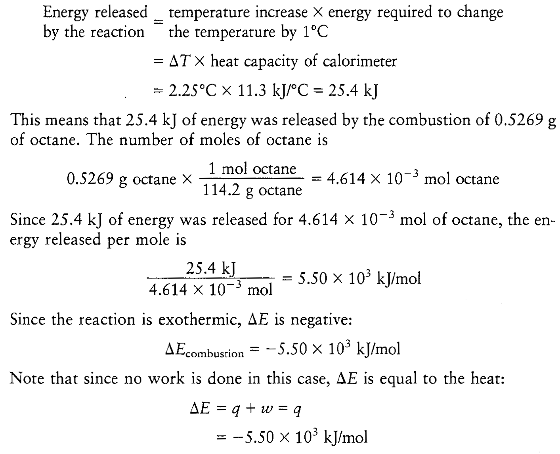

Slide 36
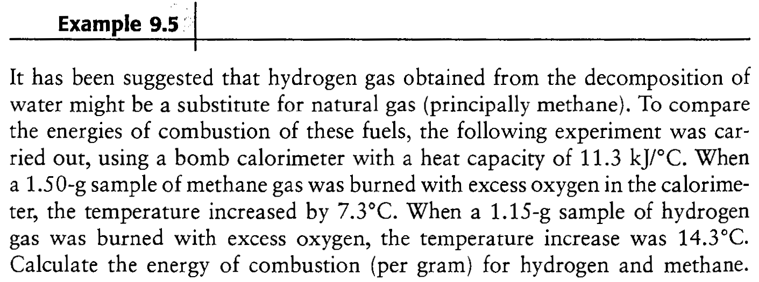

Slide 37
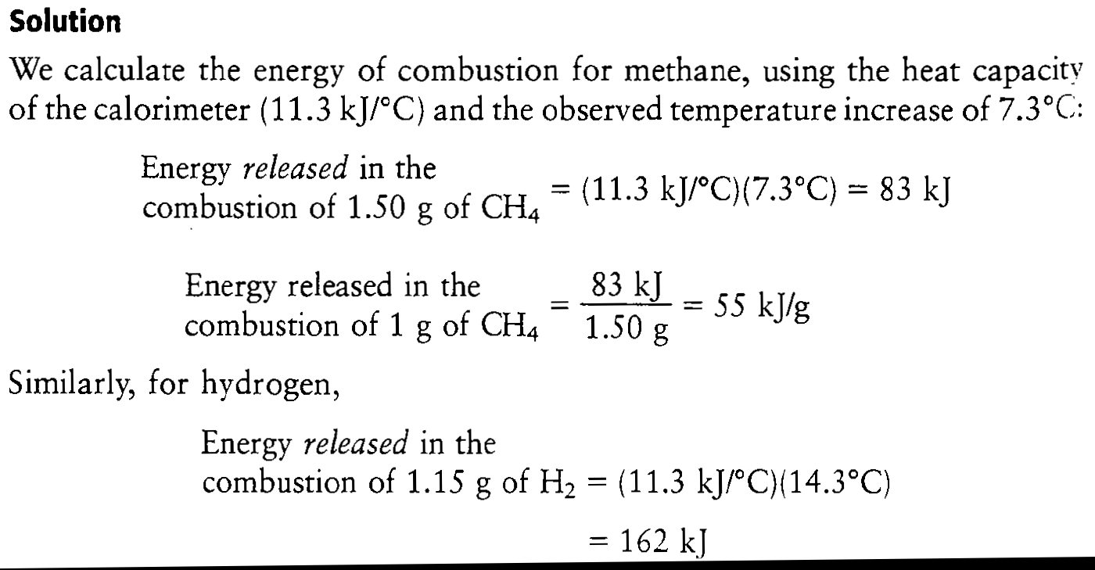
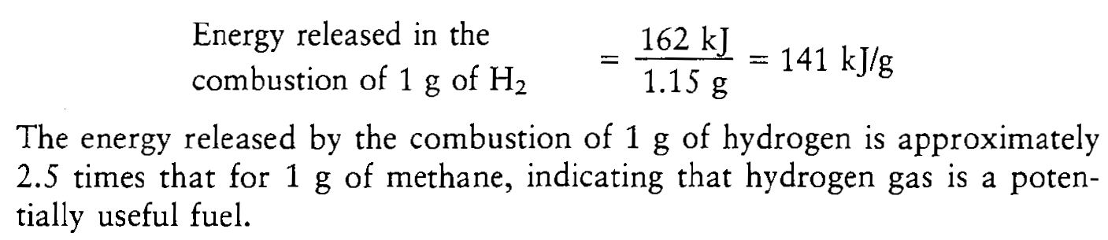

Slide 38
The enthalpy is a state function.
The change in enthalpy in going from a particular set of reactants to a particular set of products is the same whether the reaction takes place in one step or in a series of steps.
Consider the oxidation of nitrogen to produce nitrogen dioxide.
The overall reaction can be written in one step:

Slide 39
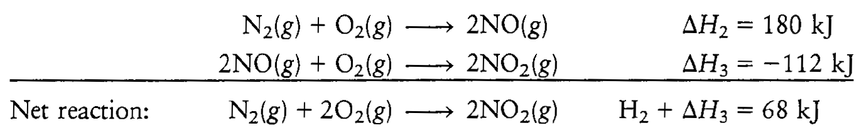
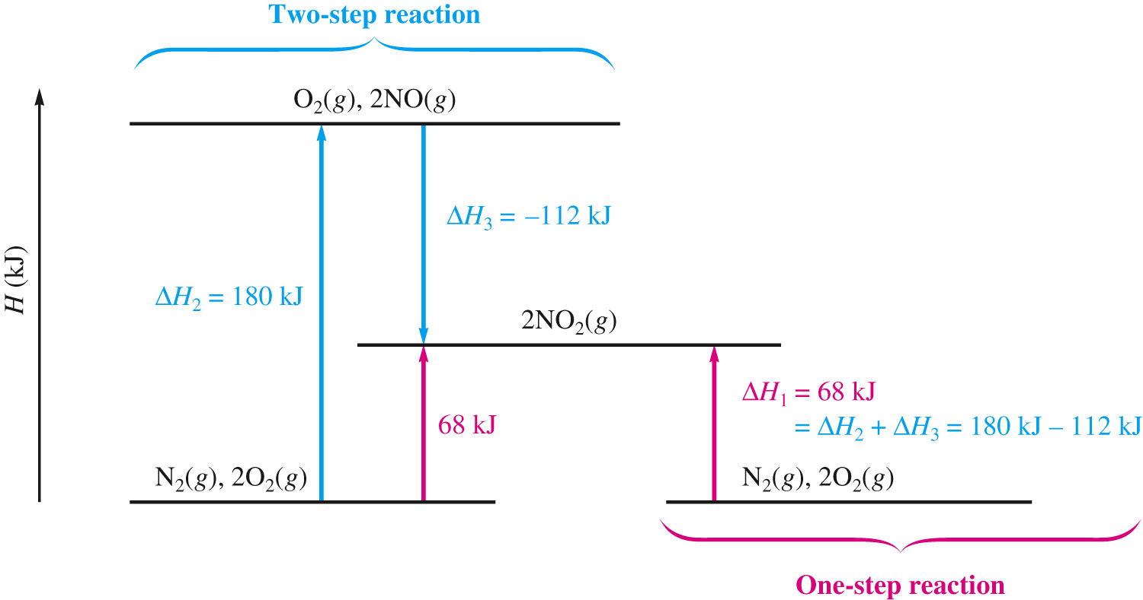
Or in two distinct steps:
The sum of the two steps gives the net, or overall reaction and ΔH₁ = ΔH₂ + ΔH₃ = 68 kJ

Slide 40
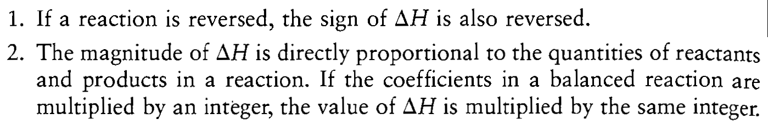
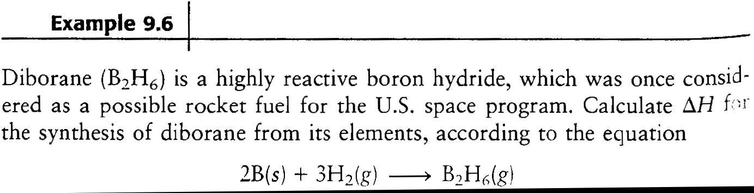
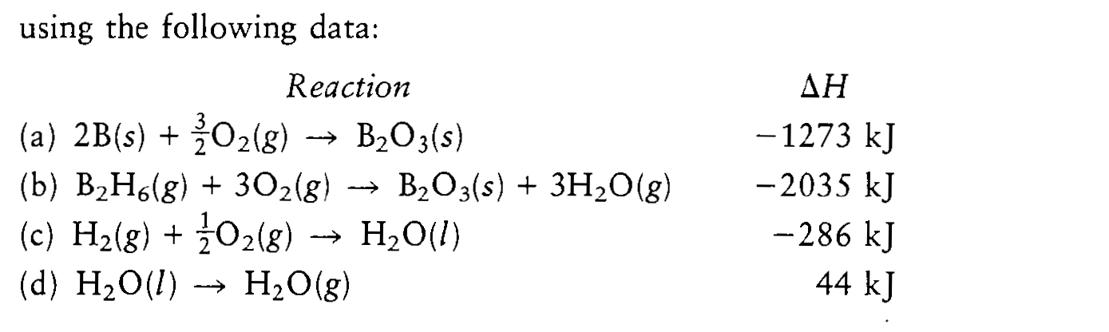
Characteristics of Enthalpy Changes

Slide 41
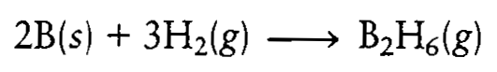
ΔH = [-1273 + 2035 + 3(-286) +3(44)] kJ = +36 kJ

Slide 42
The standard enthalpy of formation of a compound is the change in enthalpy that accompanies the formation of 1 mole of a compound from its elements with all substances in their standard states.
The superscript zero indicates that the process has been carried out under standard conditions (standard state).
Examples:
The formation of nitrogen dioxide:
½ N₂(g) + O₂(g) → NO₂(g) = 34 kJ/mol
The formation reaction of methanol:
C(s) + 2H₂(g) + 1/2O₂(g) → CH₃OH(l) = -239 kJ/mol

Slide 43
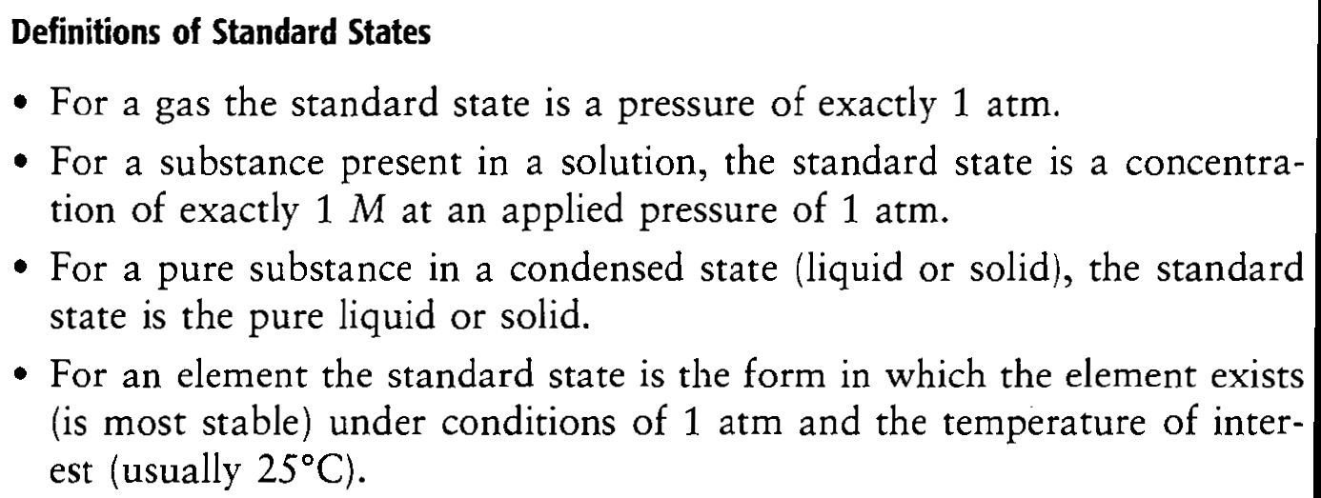
Enthalpies of formation are always given per mole of product with the product in its standard state.

Slide 44
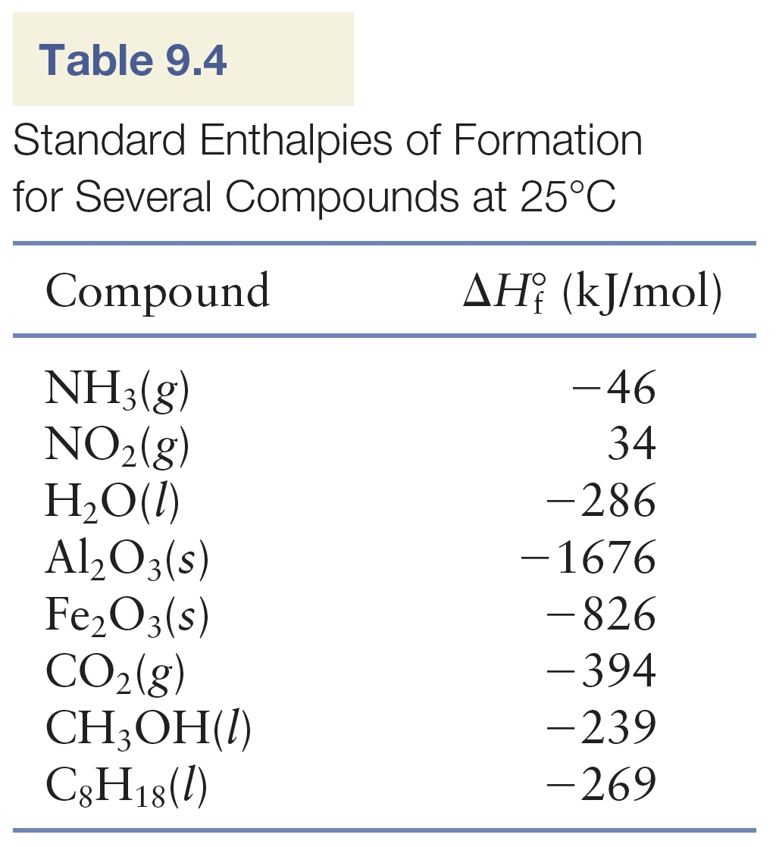
The enthalpy of formation of an element in its standard state is zero.

Slide 45
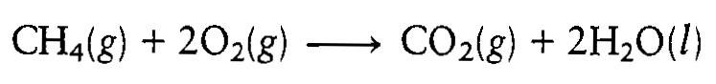
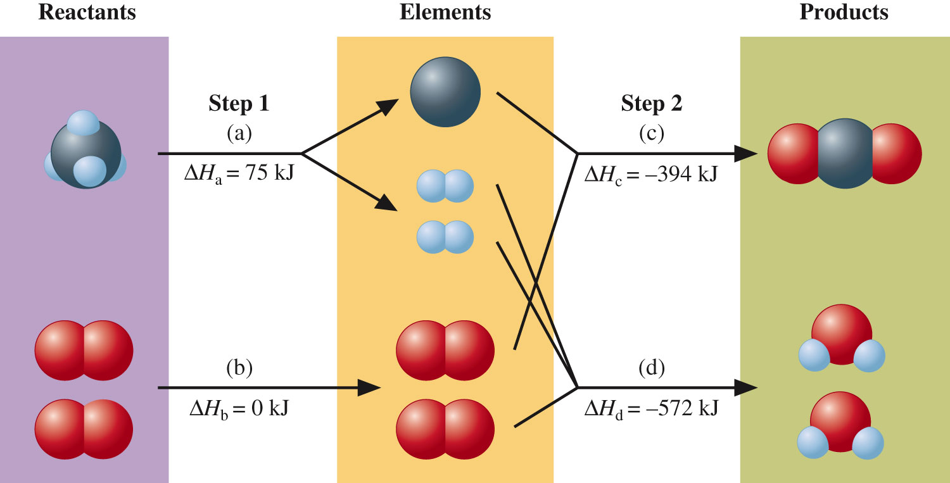
Since enthalpy is a state function, we can invoke Hess’s law and choose any convenient pathway from reactants to products and then sum the enthalpy changes.
Pathway involves taking the reactants apart into the respective elements in their standard states in reactions (a) and (b) and then forming the products from these elements in reactions (c) and (d)

Slide 46
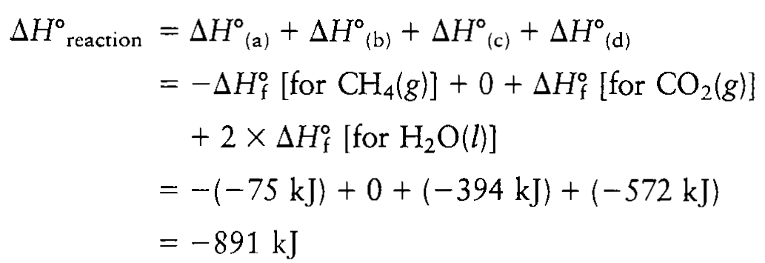
The enthalpy change for a given reaction can be calculated by subtracting the enthalpies of formation of the reactants from the enthalpies of formation of the products.
ν_{i} and ν_{j} are the stochiometric coefficients of the products and reactants from the balanced chemical equation.

Slide 47
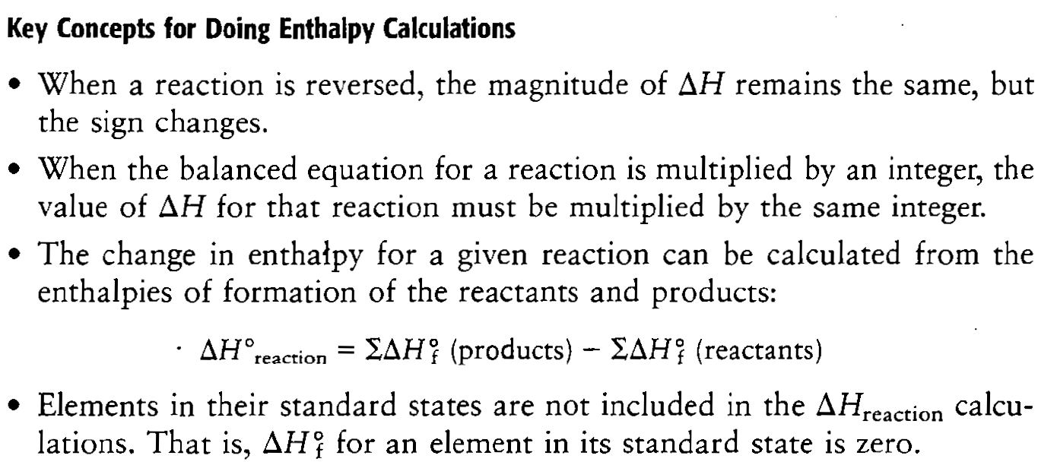

Slide 48
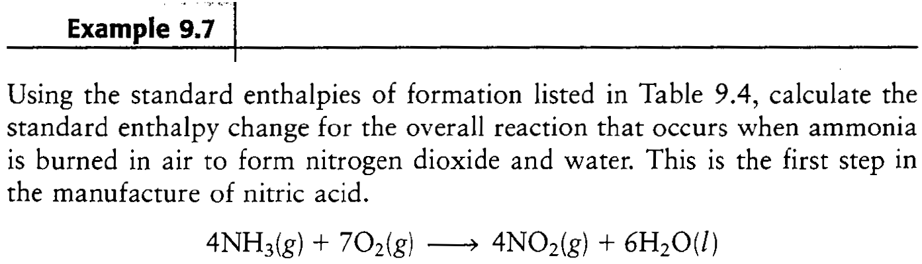

Slide 49
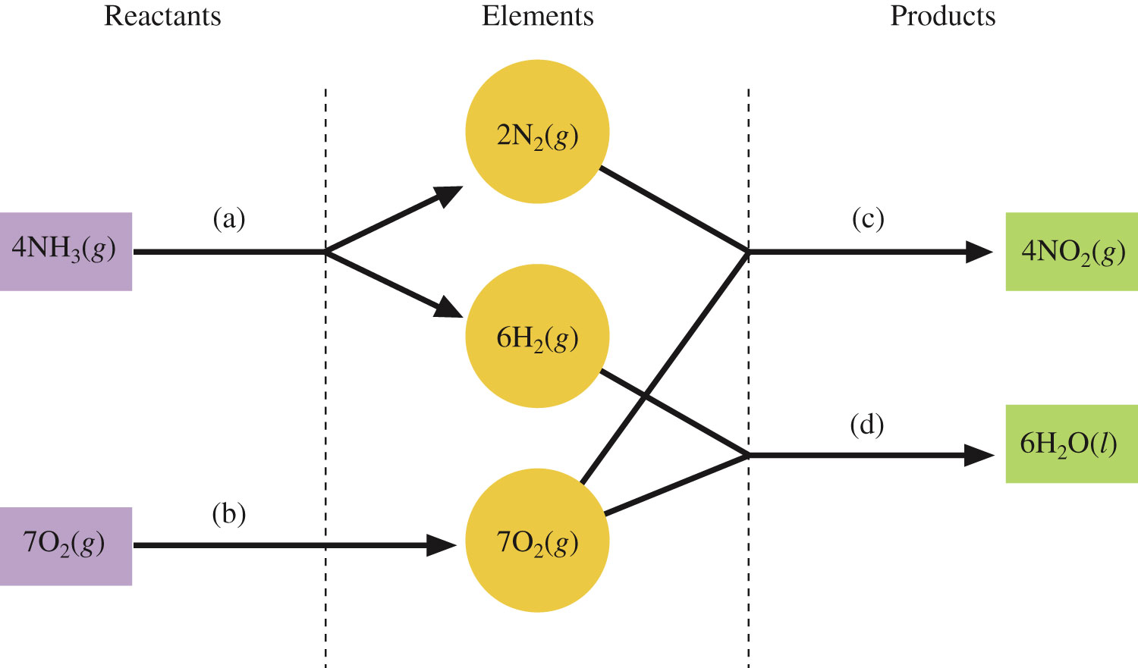
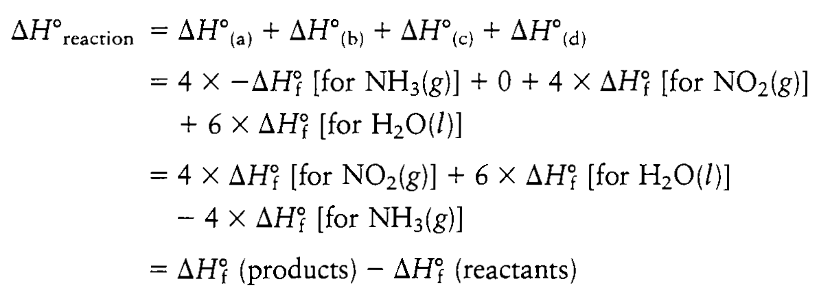

Slide 50
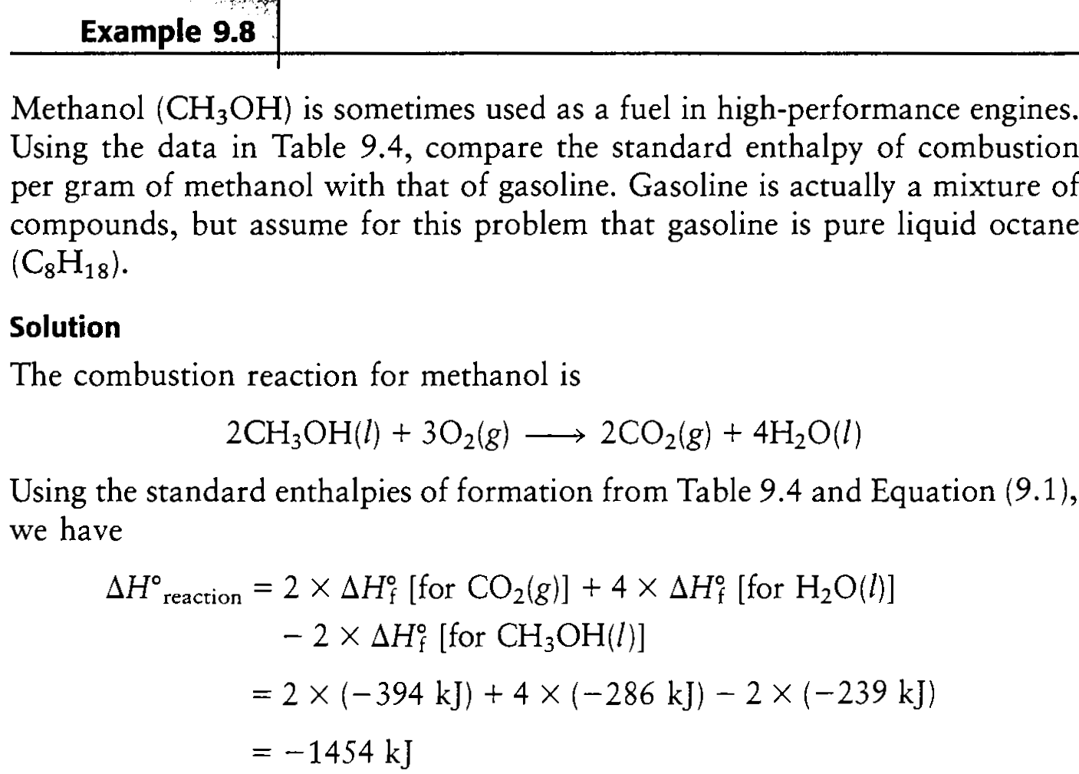

Slide 51
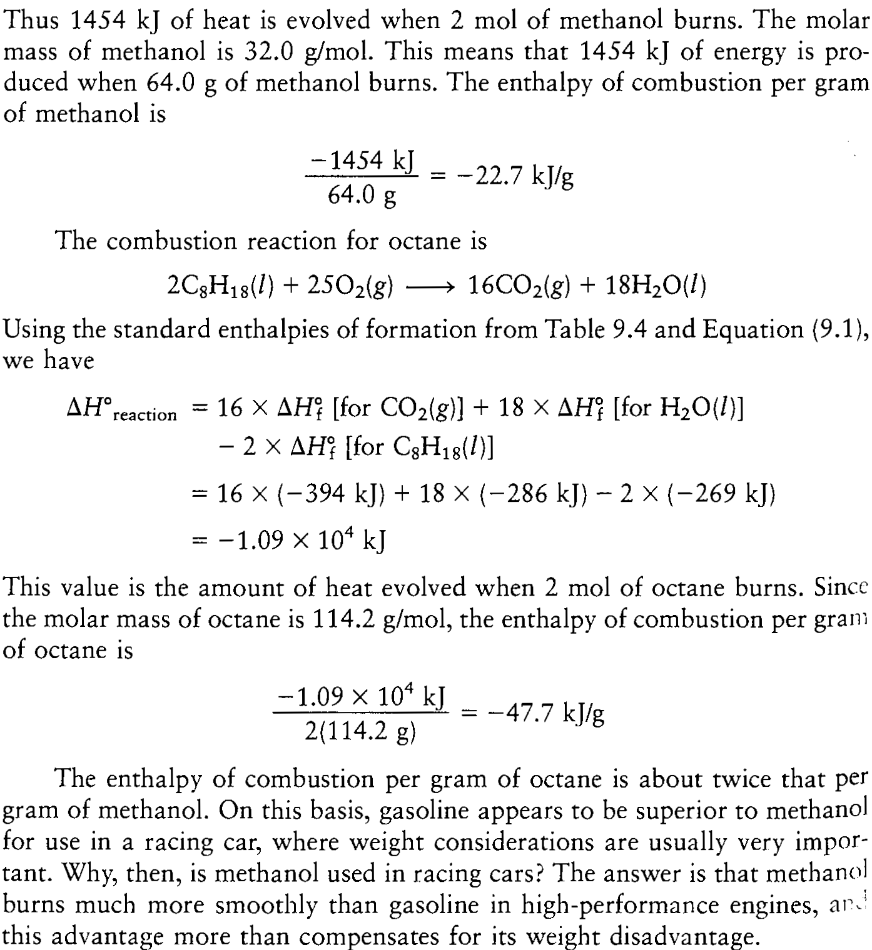

Slide 52
HOMEWORK
Chap.9: 18, 19, 26, 41, 43, 44, 48, 49,
57, 62, 74, 77

Slide 53
18
Calculate the internal energy change for each of the following:
a) One hundred (100.) joules of work are required to compress a gas. At the same time, the gas releases 23 J of heat.
b) A piston is compressed from a volume of 8.30 L to 2.80 L against a constant pressure of 1.90 atm. In the process, there is a heat gain by the system of 350 J.
c) A piston expands against 1.00 atm of pressure from 11.2 L to 29.1 L. In the process, 1037 J of heat is absorbed.

Slide 54
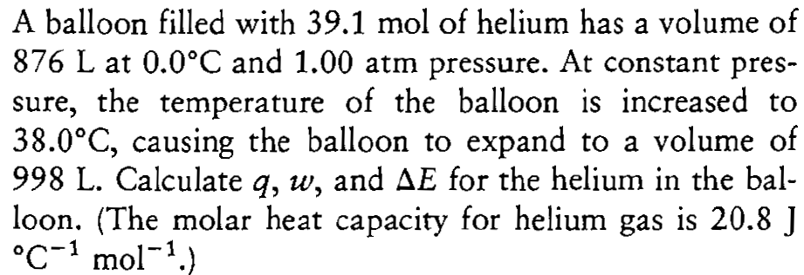
19

Slide 55
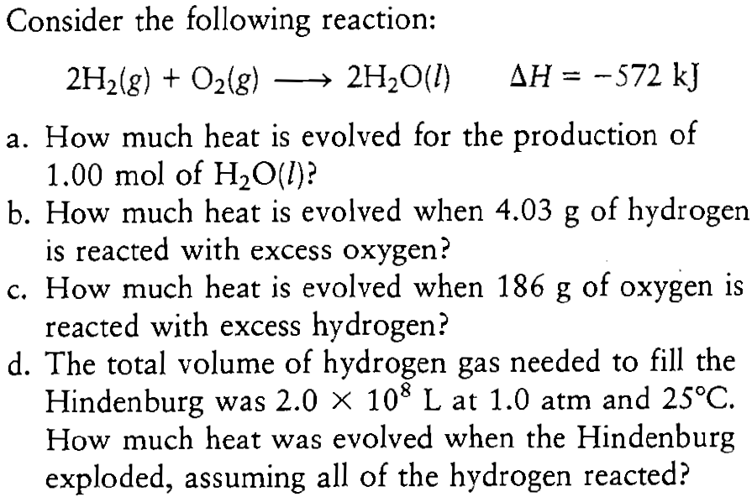
26

Slide 56
41
A sample of nickel is heated to 99.8⁰C and placed in a coffee cup calorimeter containing 150.0 g water at 23.5⁰C. After the metal cools, the final temperature of metal and water mixture is 25.0⁰C. If the specific heat capacity of nickel is 0.444 J/⁰C·g, what mass of nickel was originally heated? Assume no heat loss to the surroundings.

Slide 57
43
A biology experiment requires the preparation of a water bath at 37⁰C (body temperature). The temperature of the cold tap water is 22.0⁰C, and the temperature of the hot tap water is 55.0⁰C. If a student starts with 90.0 g of cold water, what mass of hot water must be added to reach 37.0⁰C?

Slide 58
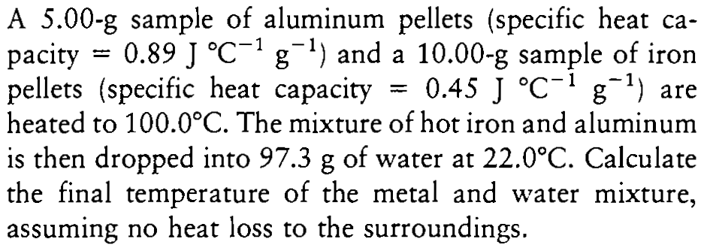
44

Slide 59
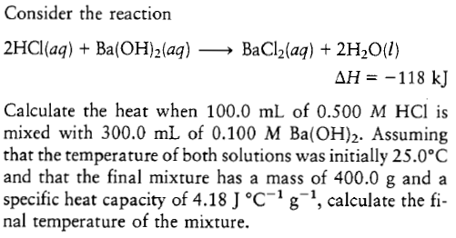
48

Slide 60
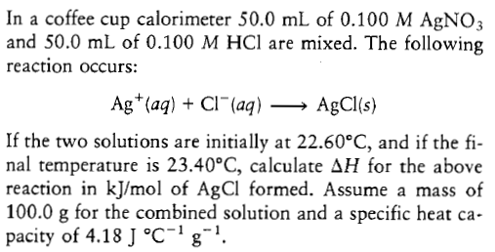
49

Slide 61
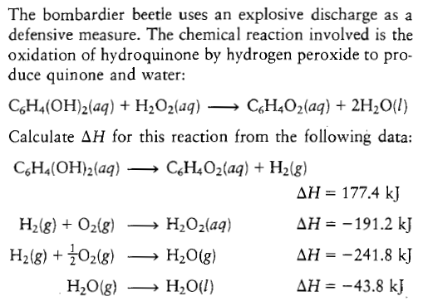
57

Slide 62
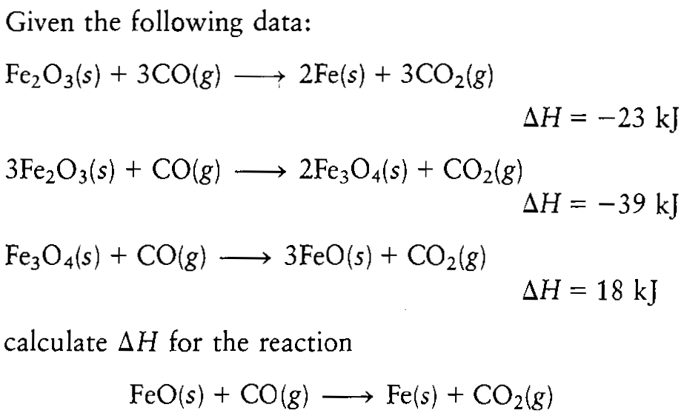
62

Slide 63

74

Slide 64

77
_{(CO)} = 110.5 kJ/mol

